Slide 1


SINSIN
  Enhancing the MEOSAR
  EUSPACEWEEK Marseille 3.12.2018

Slide 2
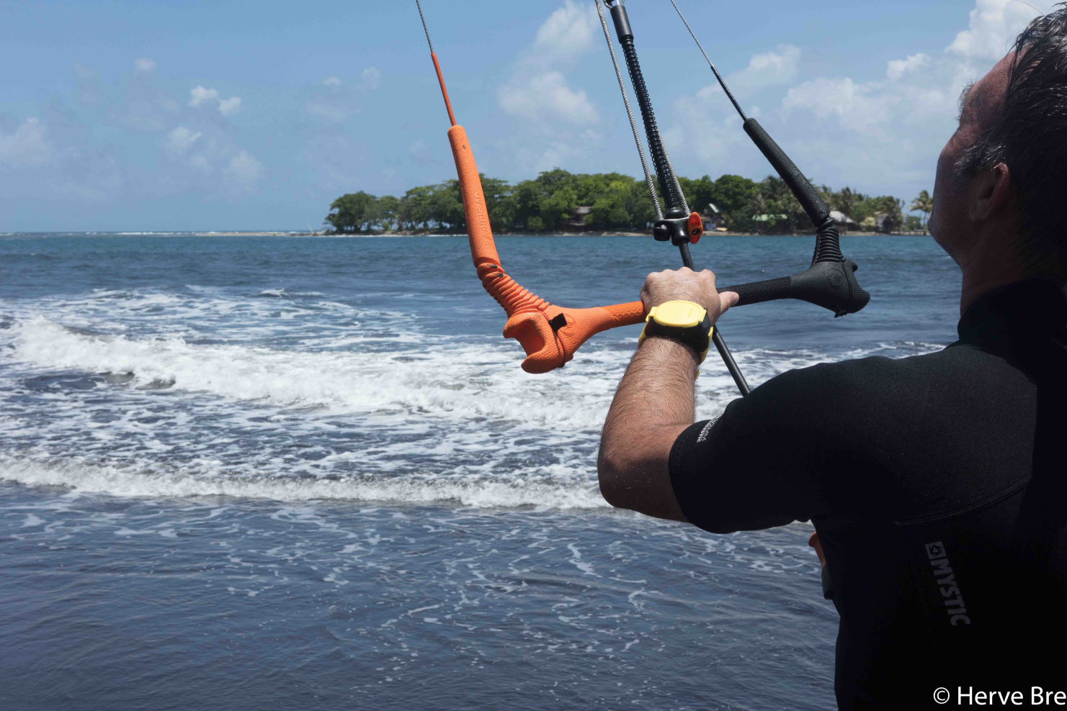
About Mobit
  Beacon manufacturer
  Coordinator of H2020 GSA Projects SAT406M, SINSIN
  www.sat406.com

Slide 3
MEOSAR System

Slide 4
User Requirements
Regarding the Personal Locator Beacon and SAR service
User Needs | SINSIN Answers
Always accessible PLB | Wrist-worn PLB
Distress call acknowledgement | RLS enabled PLB
Localization accuracy better than 30m particularly relevant to MOB/POB | Refine encoded-GNSS position resolution from 125m to 15m
Localization accuracy while moving relevant to > 50% of marine beacons | Improve localization accuracy of slow-moving beacon
On-scene localization when approaching the PLB user | Upgrade DF to LAT/LON
Large Area Coverage | Increase Coverage Area
Localization in limited sky view typically relevant in terrestrial SAR | Localization with as few as 2 (single burst) or 1 (multi-burst) sats

Slide 5
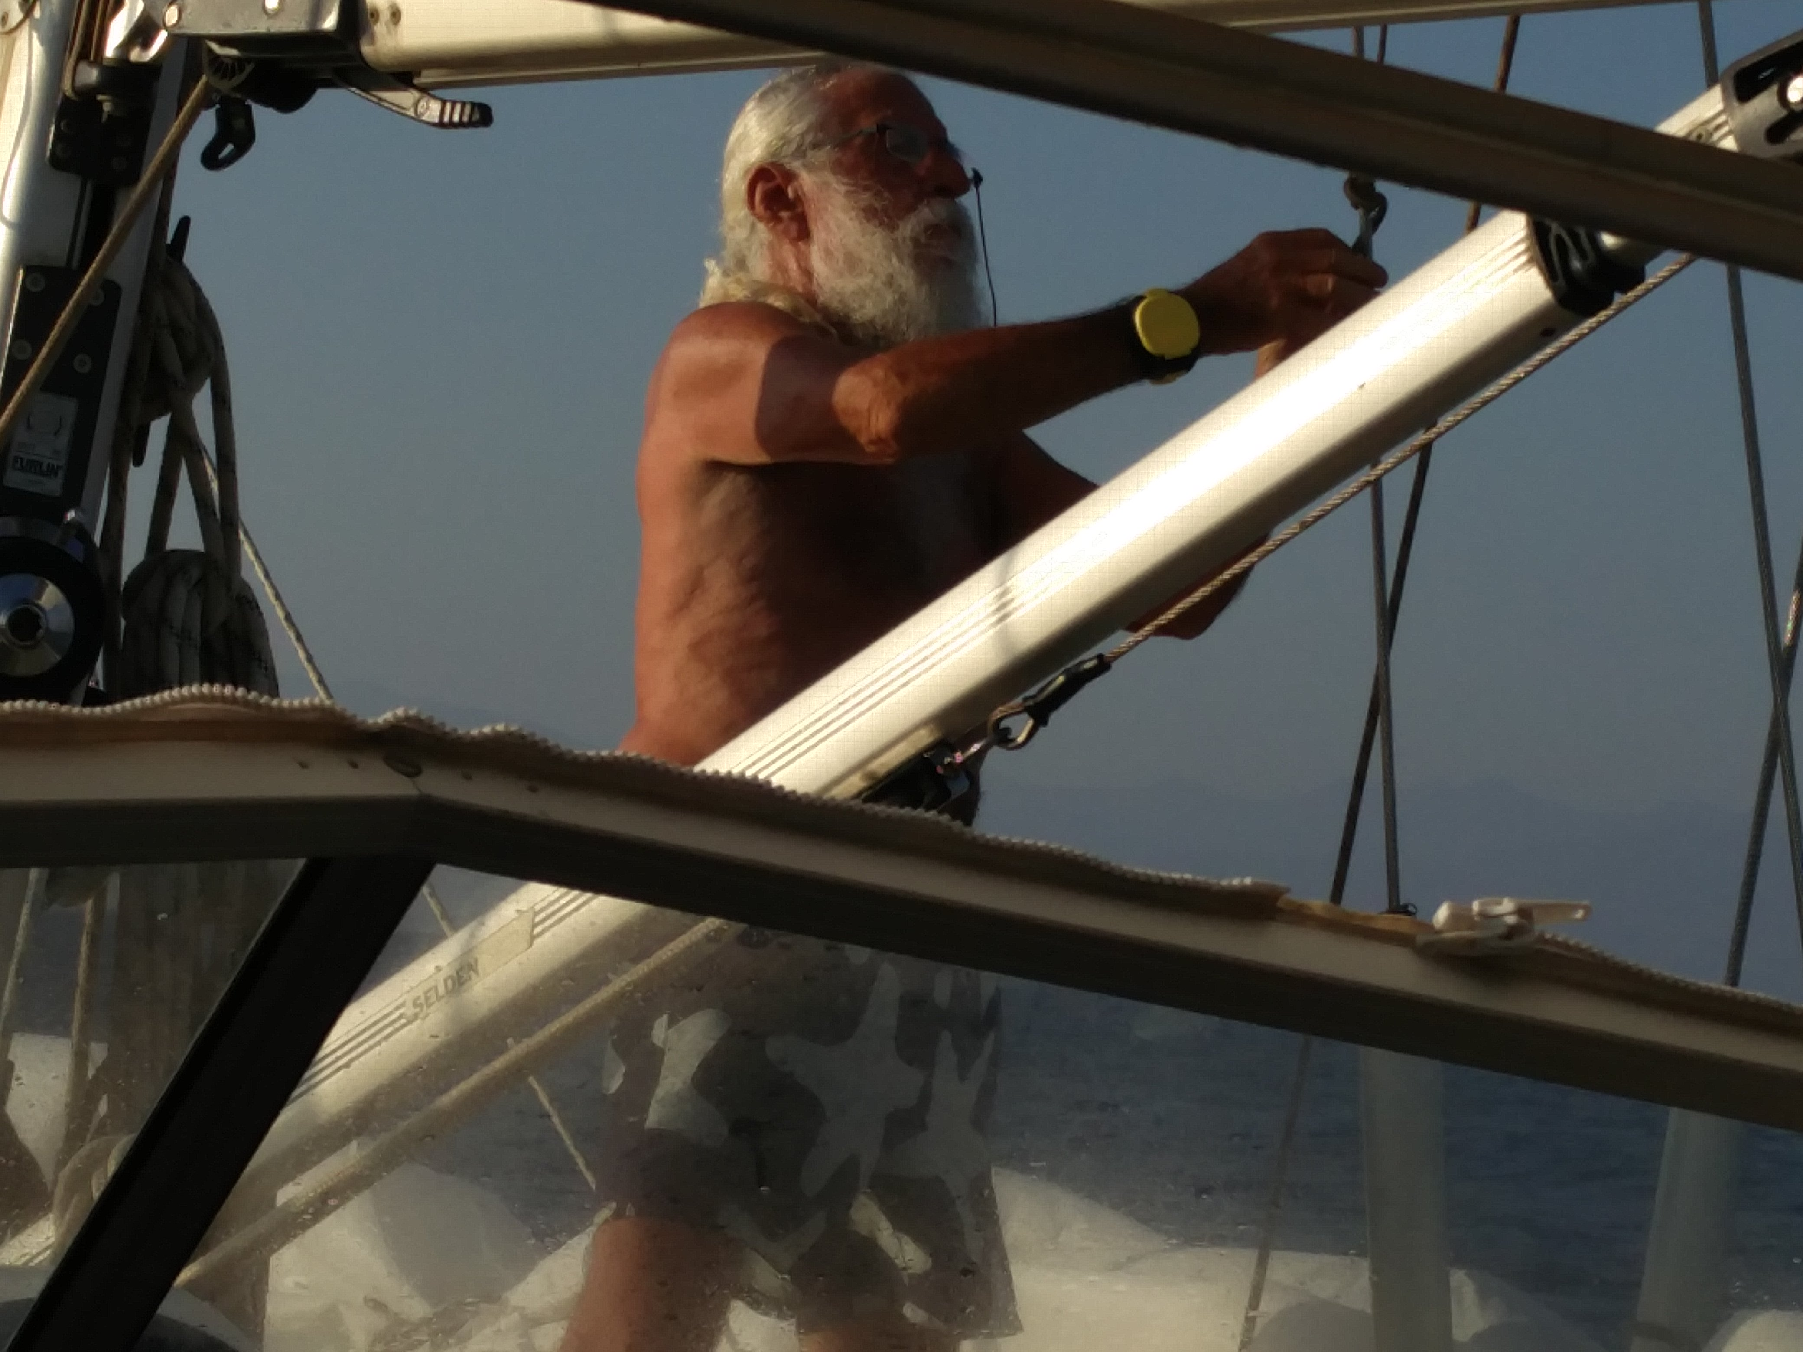
Wrist-worn PLB

Slide 6
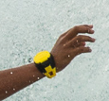
RLS Enabled
RLM
Request
RLM
Received =
acknowledge
  PLB display

Slide 7
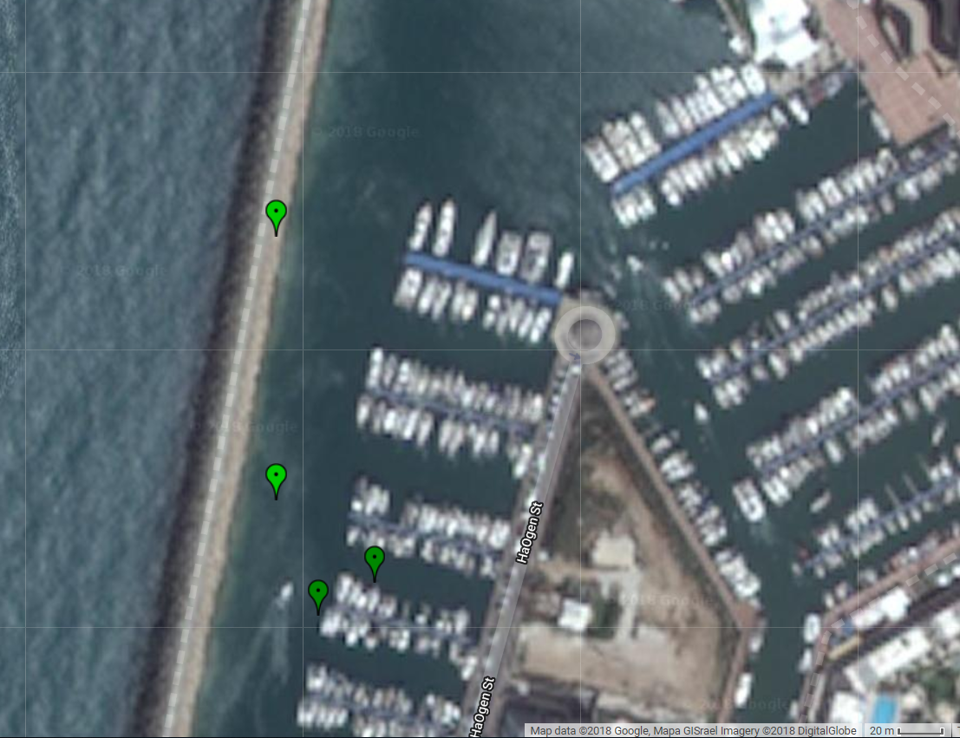
Refine encoded-GNSS position
Standard encoded-GNSS Position
Standard encoded-GNSS Position
Think of Man/Person overboard at dark/ stormy night, locatable at 15m (SINSIN) instead of 125m (standard)
Actual Position
Refined GNSS Position
Refined GNSS Position

Slide 8
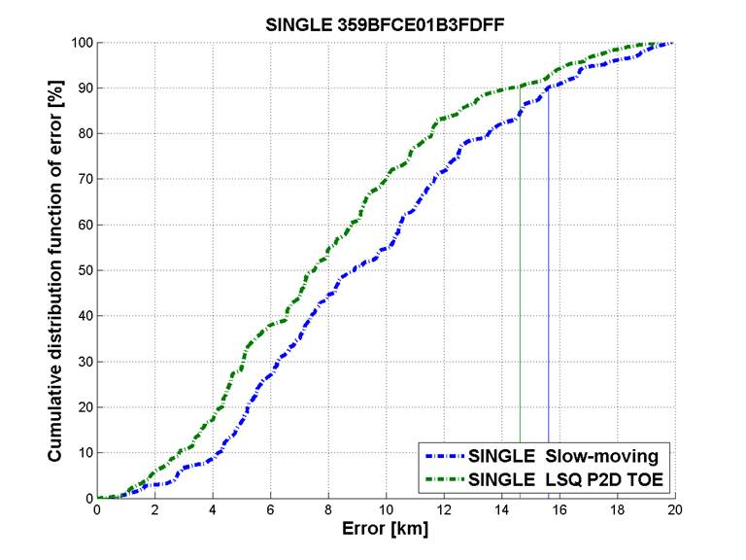
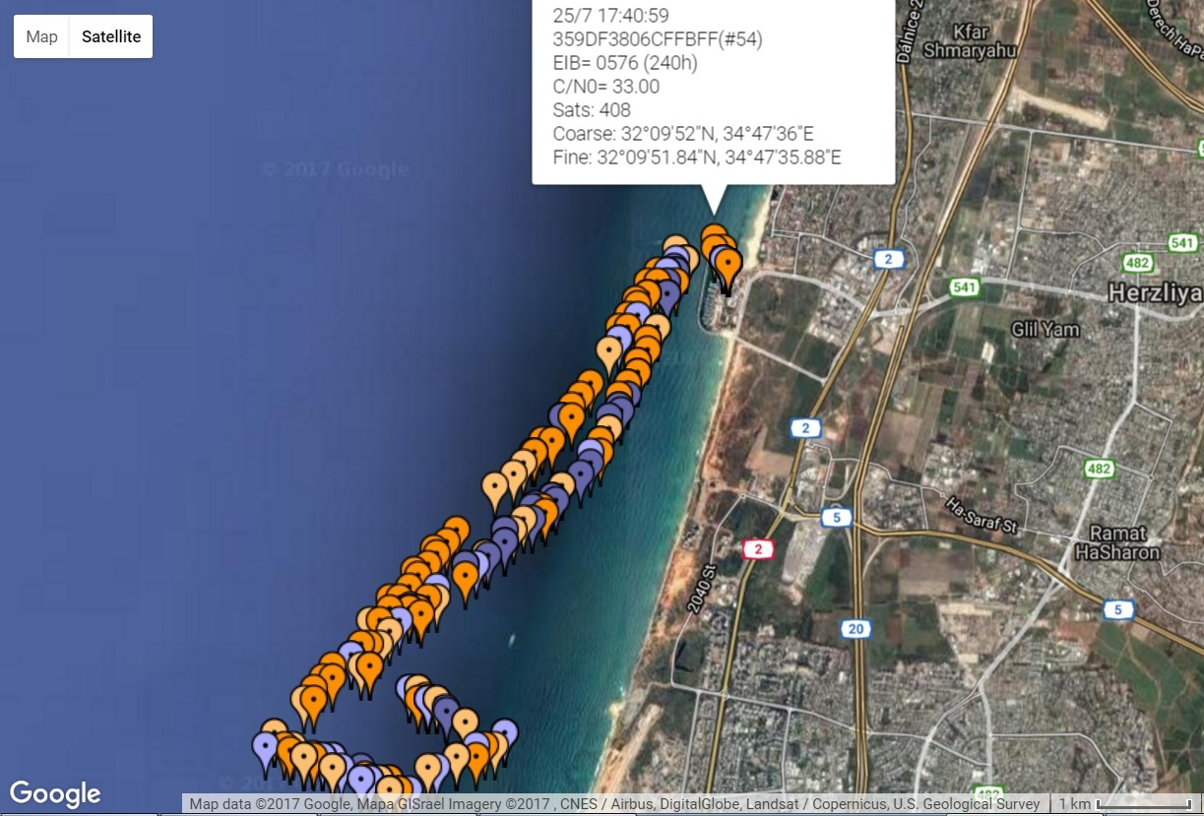
Slow moving beacon
Improve localization of slow-moving beacon

Slide 9
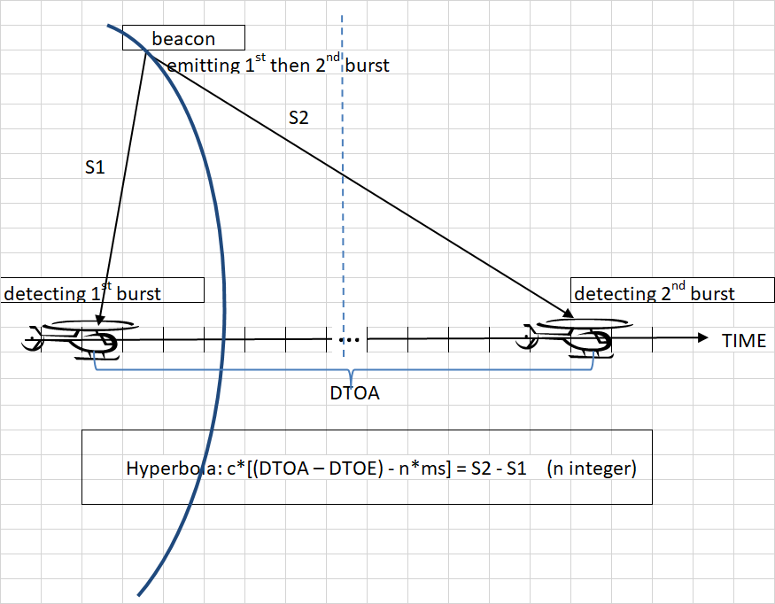
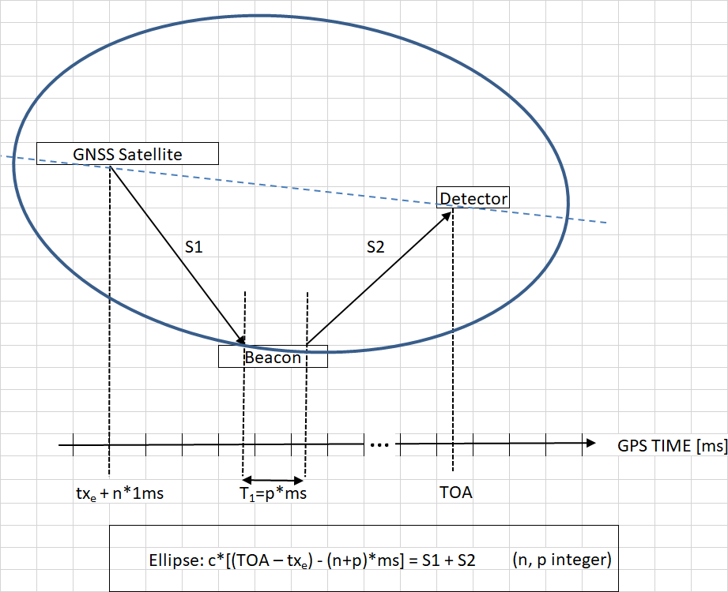
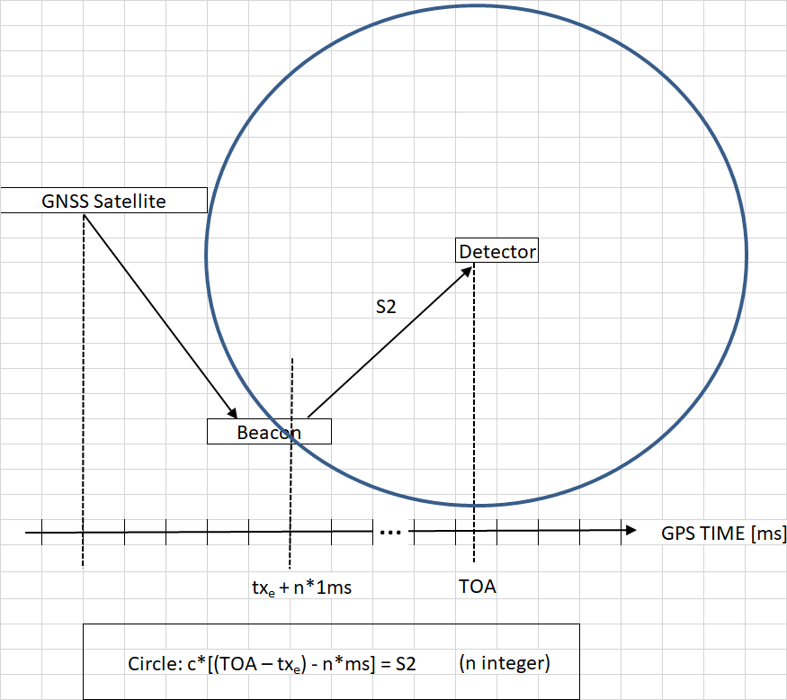
DF to LAT/LON
Presently DF provides the bearing,
SINSIN adds the hyperbola (a), ellipse (b) or circle (c) LOP
By methodically controlling the beacon Time of Emission
SINSIN-a SINSIN-b SINSIN-c

Slide 10
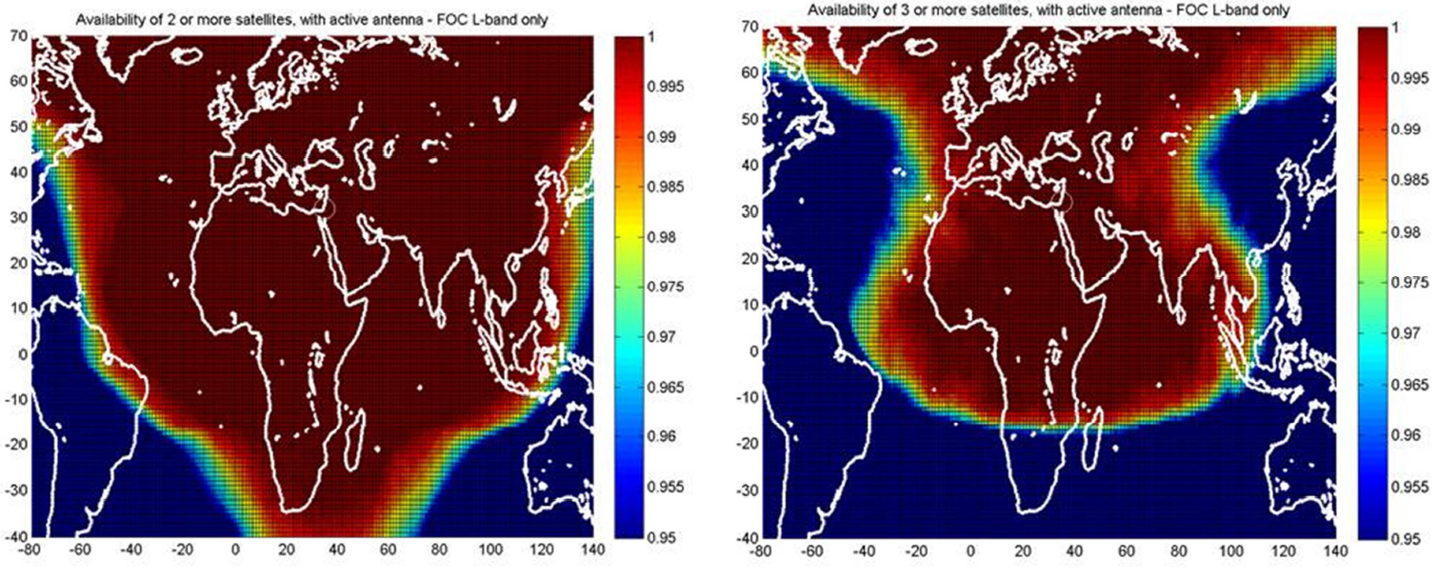
MEOLUT Larger Coverage
with SINSIN without SINSIN

Slide 11
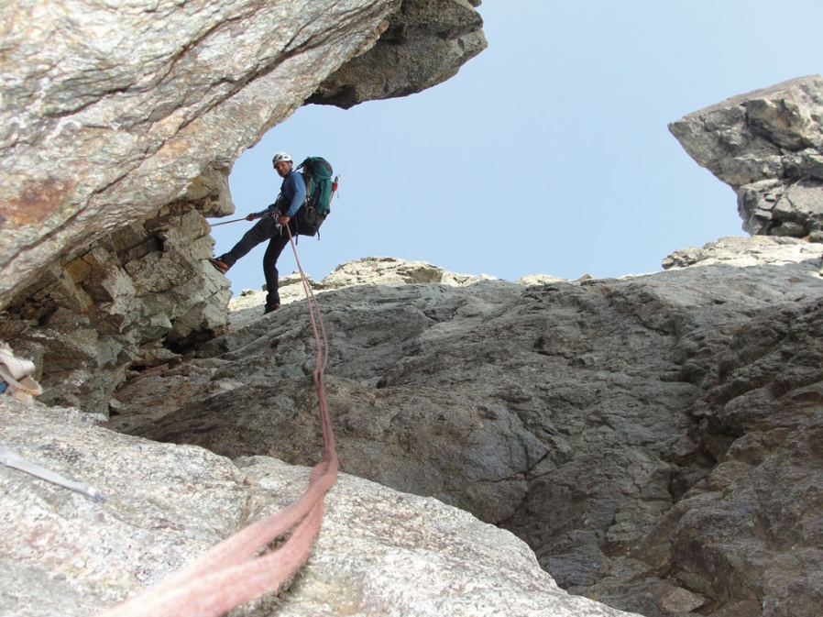
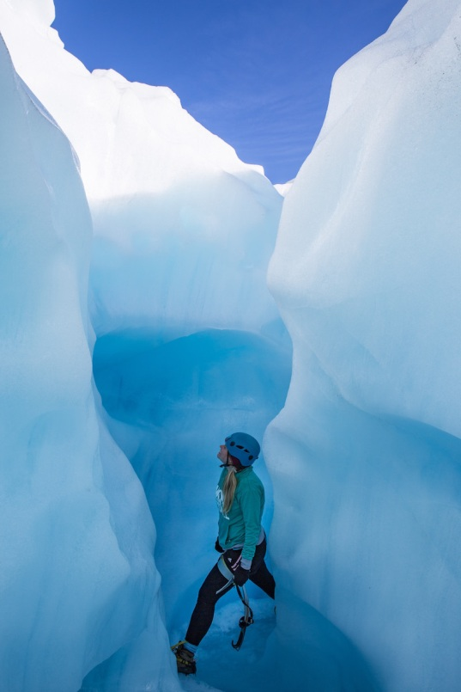
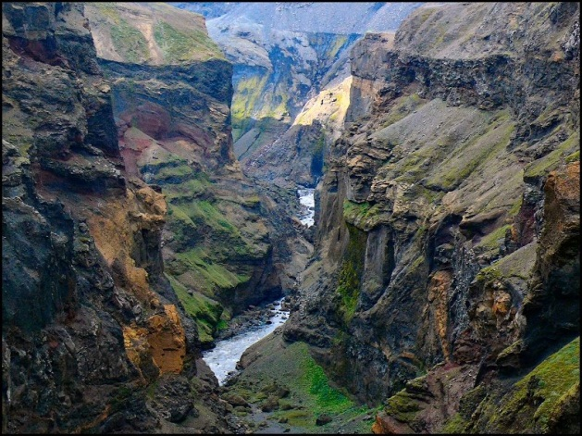
Localization with 1-2 satellites
Particularly effective in mountains, canyons, forests

Slide 12
Status
Developed in H2020 GSA Projects
SAT406M - 2015-2017
SINSIN - 2018 - 2020
Implemented in
Mobit SAT406M beacon
Thales Alenia Space MEOLUT-Next
STMicroelectronics TESEO chipset (in progress)
Analyzed in more than 12,000 bursts via SAR/Galileo
  www.sat406M-GSA-project.com
  www.SINSIN-GSA-project.com

Slide 13

Thank You!
  Daniel Katz, Mobit Telecom

